Slide 1
OpenWorm
http://www.openworm.org

Slide 2
OpenWorm’s goal
Long term
Full scale simulation of an organism, C. elegans
Medium term
Accurately predict simple animal behavior using a computer model.
Szigeti et al,
Front. Comp. Neuro., 2014

Slide 3
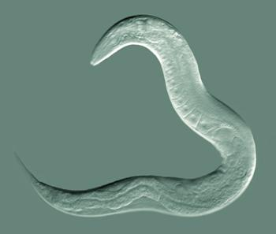
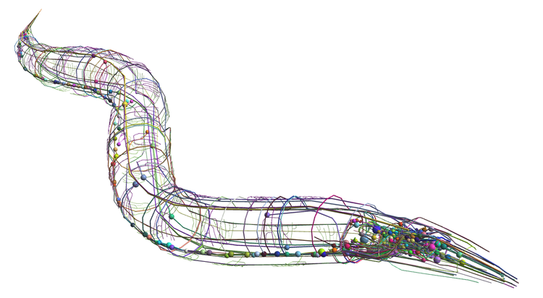
A complete simulation of the worm’s brain, body and environment
Simulated
World
Detailed simulation of worm neurons
Detailed simulation of worm body

Slide 4

The goal: understanding a faithfully simulated nervous system end to end

Slide 5
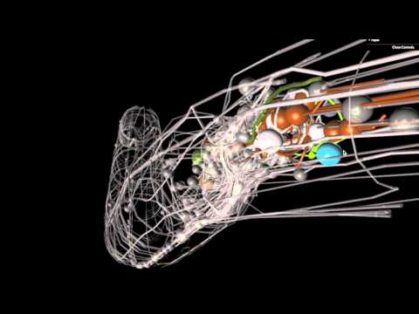
C. elegans background
Behavior
Seeks out food & mates
Avoids predators & toxins
Has social behaviors
Genomics
First fully sequenced organism
Cellular anatomy
302 neurons, 95 muscle cells, ~1000 total cells
Every cell division from fertilized egg to adult is known
Connectome
Only full organism connectome completed to date.

Slide 6
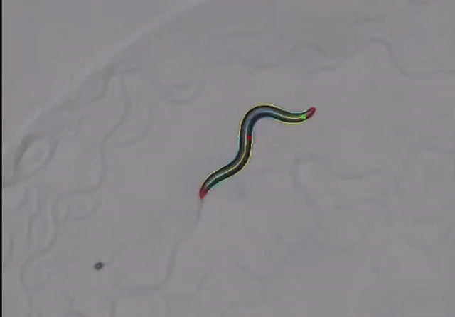
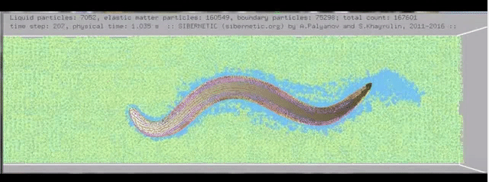
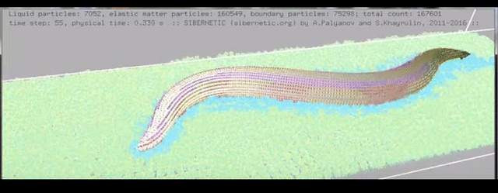
Sibernetic
Palyanov, Khayrulin, (unpublished)

Slide 7
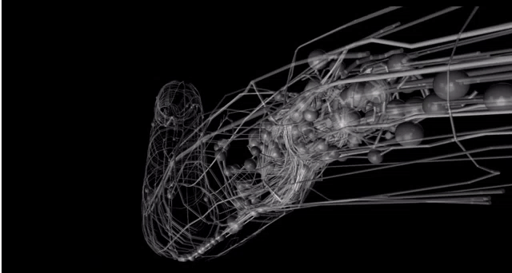

C. elegans connectome
Padraig Gleeson
Tim Busbice
Chris Grove
Matteo Cantarelli
NeuroML represenation of c. elegans conectome on OpenSource
Brain

Slide 8
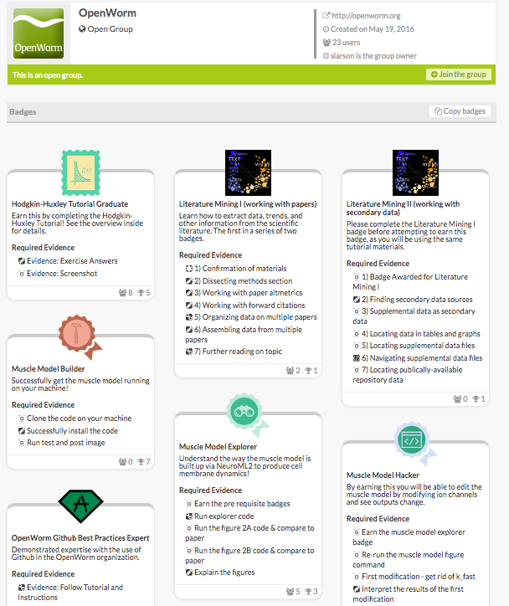
Try earning our badges at http://badgelist.com/openworm

Slide 9

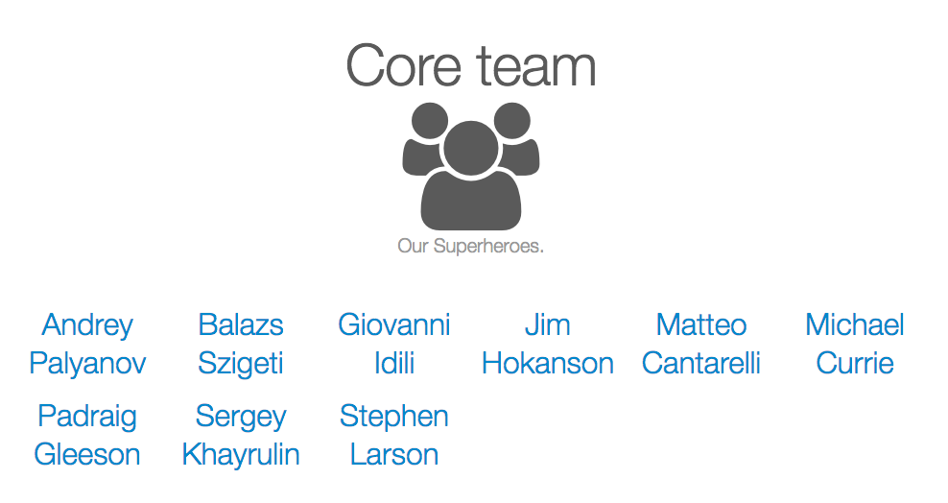


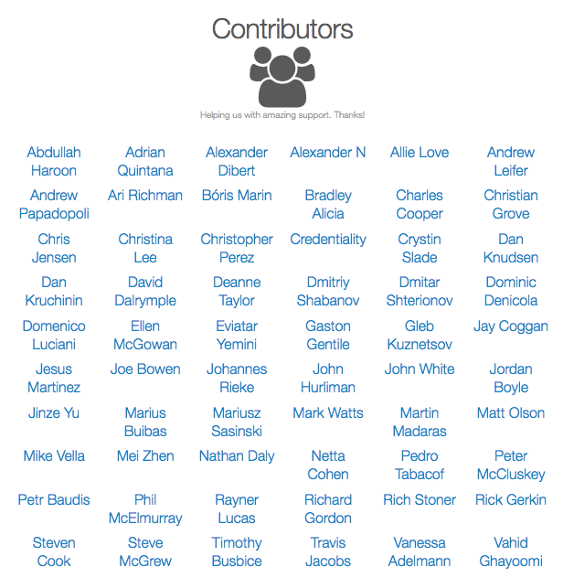





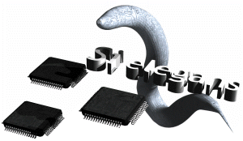

Foundation
Notes:
/

